Slide 1
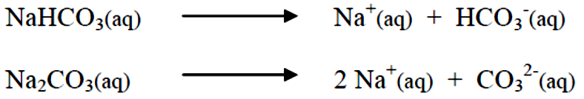
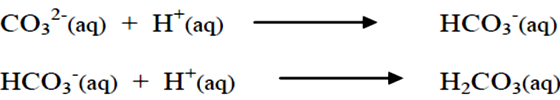
AlKarkh University of Science College of science First year level
General chemistry Labs
Supervisor: Dr. Mohammed Abdul Baset Assistant: Anssam Dhaher Huessin
Lab -11-
Titration of a Mixture of Carbonate (CO3²⁻) and Bicarbonate (NaHCO3⁻)
1. Introduction:
• A volumetric analysis involves measuring the volume of a solution of known concentration, the Titrant, which is needed to completely react with an Analyte; Sodium Bicarbonate and Sodium Carbonate, in the present case.
• This titration reaction is complete when a stoichiometrically equivalent amount of titrant has been added to the analyte and all the analyte has been consumed.
• The point at which this occurs, called the Endpoint, is visually noted because an added Indicator changes color, or has some other distinct visual change, when the titration reaction is complete.
• The trick in any titration is to stop adding titrant at the exact point at which the indicator's color changes because only at this point will a stoichiometrically correct amount of titrant have been added to the analyte.
• In this experiment, we have two analytes in our sample; Sodium Bicarbonate and Sodium Carbonate. Both of these Sodium salts are water soluble and ionize upon solvation in Water:
• The resulting Bicarbonate (HCO3⁻) and Carbonate (CO3²⁻) ions are both basic. Hence, they will react with a strong acid such as Hydrochloric Acid (HCl), which itself ionizes to H⁺(aq) and Cl'(aq) in Water.
• Therefore, an acid such as HCl can serve as the titrant for our titration.
• Because we have two analytes, HCO3⁻ and CO3²⁻, we will need two different indicators, one to indicate the endpoint for the reaction between H⁺ and CO3²⁻ and the other to indicate the endpoint for the reaction between H⁺ and HCO3⁻. The indicator Phenolphthalein will serve as an endpoint indicator for the former reaction and Bromcresol Green will indicate the endpoint for the latter.
33

Slide 2
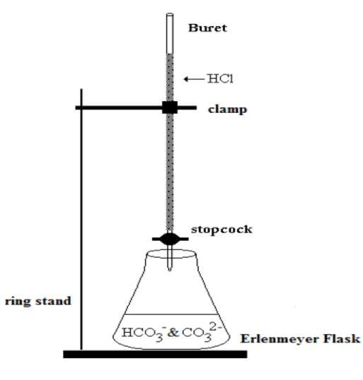
• We will add acid to a solution of our sample until the acid completely reacts with the Carbonate (CO₃²⁻) present to form Bicarbonate (HCO₃⁻). The number moles Carbonate present can be determined from the Volume and Molarity of the acid added:
• The Endpoint of this reaction can be detected because the Acid-Base Indicator Phenolphthalein will change color from Pink to clear at the pH prevailing when this reaction is complete.
• After this endpoint is reached, the acid will begin reacting with the Bicarbonate just generated and the Bicarbonate present in the initial sample. And, again, knowing the Volume and Molarity of the added acid, we can determine the number moles Bicarbonate:
• The Endpoint of this reaction can be detected by using the Acid-Base Indicator Bromocresol Green; which changes from Blue to Yellow at the pH that prevails at the completion of this reaction. The amount of Bicarbonate present in the original sample will then be the difference between the total Bicarbonate determined above and the amount generated by the Carbonate initially present. Thus, the amount of Bicarbonate originally present in our sample is given by: •
• This entire procedure depends on knowing the concentration of the acid used as the titrant. We will determine this concentration using a Standardization procedure. This involves performing the same experiment on a sample of Sodium Carbonate of known mass.
34

Slide 3
2. Procedure:
1. Preparation of ~0.1M HCl Solution
o Use the 8M HCl provided to prepare 400 mL of ~0.1M HCl. Have your instructor check your Pre-Lab calculation before you proceed.
2. Standardization
o Set-up a buret to deliver your acid solution. Your instructor will demonstrate how to use this device. Do not proceed without this instruction.
o Fill your buret with the HCl solution. Your instructor will demonstrate this. Make sure the buret tip is full. Make an initial volume reading to the correct precision;
0.02 mL for a 50 mL buret.
o Weigh a sample of 0.20g Sodium Carbonate to a precision of 0.1mg on glazed weighing paper. Add this to a 250 mL Erlenmeyer flask. Add about 25 mL Water and swirl to dissolve the Carbonate. Add a few drops of Phenolphthalein.
o Begin adding the acid to the flask from the buret no faster than 0.5 mL/second. Swirl the flask constantly. Continue until the pink color disappears. Now add 2-4 drops of Bromocresol Green (blue at high pH and yellow at low pH). Titrate to a blue-green color, which appears just before the Endpoint. Interrupt the titration at this point and boil the solution carefully for two or three minutes to drive off the Carbon Dioxide. This helps drive the reaction to completion. The color should revert to blue. Cool the solution to Room Temperature (~10 minutes) and continue the addition of acid to the pale green Endpoint. Make a volume reading at this point.
o Repeat this procedure twice more. ³
3. Analysis of Sample
o Weigh a sample of 0.20g Sample to a precision of 0.1mg on glazed weighing paper. Add this to a 250 mL Erlenmeyer flask. Add about 25 mL Water and swirl to dissolve the Carbonate. Add a few drops of Phenolphthalein.
o Again fill your buret and make a volume reading.
o Add acid until you reach the Phenolphthalein Endpoint. Make a volume reading.
o Add a few drops of Bromocresol Green and finish the addition of acid as before.
Make a volume reading. o Repeat the procedure at least twice more.
35

